Slide 1
SHIFT: What it is and why it matters!
Mr Stephen Grice and Dr Mun-Yee Tung
Sexual Health Services
Kent Community Health NHS Foundation Trust / SHIFT PP3
30 November 2022

Slide 2
SHIFT
3 million euros
11 partners
4 years (including a pandemic)
SHIFT has brought together people aged 45 and over along with health and academic professionals; to empower people in this community to participate, co-design and improve their sexual health and wellbeing.

Slide 3
What is SHIFT?
Sexual Health In the over ForTy-fives is a project which aims to improve the sexual health and wellbeing of people over 45
Most sexual health information is geared towards certain at risk populations:
Young people
LGBTQI+
Pregnant women

Slide 4
But why SHIFT?
The World Health Organization (WHO) defines sexual health as a state of physical, emotional, mental and social wellbeing in relation to sexuality – it is not just the absence of disease, dysfunction or infirmity.
So what about the ‘silent majority’?
When did you last see any helpful publicity around sexual health or sexual wellbeing for people aged 45 plus?

Slide 5
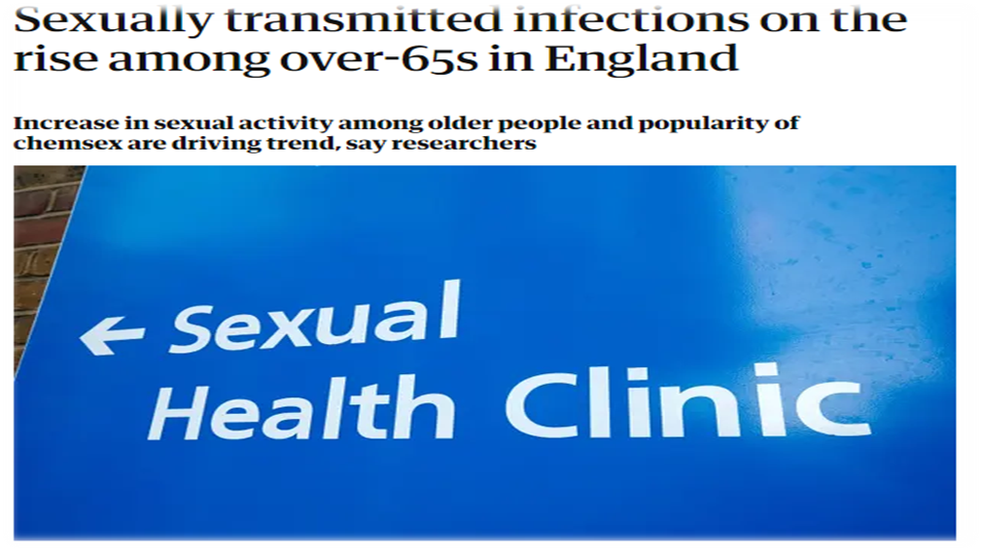
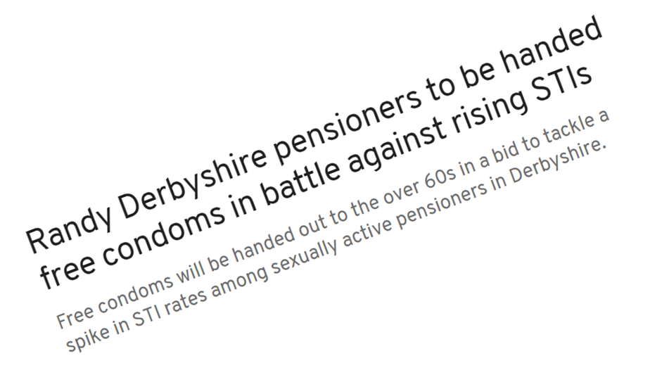

Slide 7
What is SHIFT?
There are 3 work streams in SHIFT
Work package 1: engaging with 45+ general population
Work package 2: engaging with vulnerable 45+ population (homeless, sex workers, persons with drug + alcohol dependence)
Work package 3: engaging with HCPs and people who work with and engage with populations aged 45+

Slide 8
Who is delivering SHIFT?
There are Health, Public Health, Community and Academic partners from the UK, Belgium and the Netherlands working together to co-create, pilot and embed a model to engage with people aged 45 and older.
The model has been designed with the aim of encouraging the target population to consider their sexual health and take action.
SHIFT Sexual Health and Wellbeing Model to engage people aged 45+

Slide 9
Key Target Themes of SHIFT
Knowledge
Promotion of good sex, sexual health and wellbeing
Risk, behaviours, normal ageing
Improve ease of access to information
Clear and inclusive language
Improve knowledge of HCPs and WW (WP-3)
Awareness
Campaigns internet / press publication
Peer educators / Community educators
Combining services with social events
Developing & utilising country/region-specific resources
Dedicated SHIFT website
Access
Collaborative services with communities
Online, telephone and F2F provision
Inclusive and accessible information and services
Services reflect local needs / requirements
Appointments outside ‘working hours’ to increase access across the system
What effect will COVID have?
Stigma
Change cultural societal norms about sex & sexual health
Improve communication – age / diversity / inclusive
Improved availability of information, advice, signposting
Improving trust and facilitating better relationships between the community and health care professionals

Slide 10
What does SHIFT look like – Work Package 1

Slide 11
What is the SHIFT model?
1) An illustrative model to help effect behaviour change SHIFT COM-B
Focussing on addressing: knowledge, awareness, access and stigma
2) A range of activities that help deliver the COM-B model
SHIFT Hub website
SHIFT films
SHIFT educational tools (WP-3)
SHIFT outreach work to support vulnerable groups (WP-2)

Slide 12
SHIFT hub
SHIFT hub
Asset use – advertising (websites and community locations)
Messages & language (S),
Use of evidence, facts
& narratives (K)
Advertising & communication resources
Restriction*
Education
Visibility of services (Ac/Aw),
Vetted online services (Ac),
Online self-assessment (Aw)
Positive message
framing (K), Challenging
norms (S)
Environmental
Restructuring
Persuasion
Capability
Physical
Social
Opportunity
Behaviour
Community champions,
Community assets,
Role models (Aw/K/S)
Psychological
Physical
Integration with other
Services (MECC) (Ac/Aw)
Asset use – linking services (health checks)
Advertising & communication resources
Modelling
Incentivisation
Automatic
Reflective
Enablement
Motivation
Coercion*
Reduce self-stigma, HCP
relations & communication,
Education e.g. “what is normal?”,
know your body (S)
SHIFT hub
Training
Education of clients, peers &
communities, Training of HCPs
& WW (Ac/Aw/K/S)
WP3 training and resources
Imagery – “looks like me”
WP3 training and resources
Advertising & communication resources
Notes:
Many of you will be very familiar with COM-B; The Capability, Opportunity, Motivation, Behaviour model is one theory which can contribute insights into sexual health and wellbeing behaviours, and as a result help facilitate change.
The main theory behind COM-B is that a behaviour is the result of an interaction between three components: capability, opportunity, and motivation
Purple tabs on the model - would be the activities for example, public promotion events like a pop up stand at a community event, or an advertising campaign
Blue layer – what does the activity impact: knowledge, awareness, access, stigma
Yellow layer – the purpose of the activity i.e. what is the objective we aim to resolve with the community. For example, education, enablement or modelling.

Slide 13
SHIFT portaal
SHIFT portaal
Adverteren op websites en locaties in de gemeenschap
Duidelijke boodschappen
& taalgebruik (V) ,
Gebruik van evidentie,
feiten en naratieven (K)
Reclame en communicatie-middelen
Beperking*
Voorlichting
Zichtbaarheid van diensten (T/B),
Kwalitatieve relevante online
diensten (T), Online
zelfevaluatie (B)
Training obv positieve
boodschappen (K),
Normen ter
discussie stellen (V)
Aanpassing
omgeving
Overtuiging
Capaciteit
Fysiek
Sociaal
Gelegenheid
Gedrag
Adequaat gebruik maken van beschikbare ondersteuning, integratie van dienstverlening (geïntegreerde seksuele gezondheidscontroles)
Reclame en communicatie-middelen
Spilfiguren in de gemeenschap,
‘assets’ binnen de gemeenschap
Rolmodellen (B/K/V)
Psychologisch
Fysiek
Integratie van
dienstverleningsaanbod(T/B)
Modeling
Beloning
Automatisch
Reflectief
Facilitering
Motivatie
Dwang*
Recuderen van zelfstigma,
Verbeteren van contact en
communicatie met zorgprofessionals,
Reflectie op wat ‘normaal’ is (V)
SHIFT portaal
Training
Professionalisering door onderwijs en training
Voorlichtin van cliënten, peers &
gemeenschappen, Training van
Zorgprogessionals (T/B/K/V)
Herkenbare beelden voor de doelgroep
Professionalisering door onderwijs en training
Reclame en communicatie-middelen

Slide 14
SHIFT Hub Website
https://shift-sexual-health.eu/
https://shift-sexual-health.eu/nl/

Slide 15
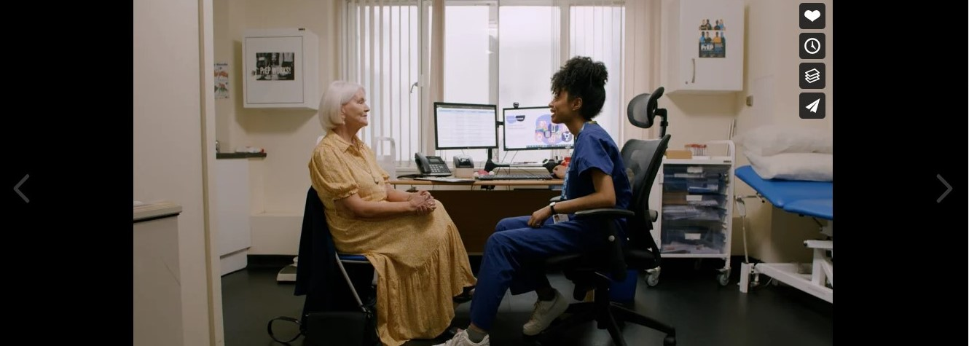
SHIFT: Hannah & Marion’s Story
https://vimeo.com/652884881/ea4c8da810

Slide 16
SHIFT – STI trends (UK data)
Increase in STIs being diagnosed in people aged 45+
Data not as rich as for younger people aged 15-49
UKHSA data have shown that the number of over-65s who had common STIs rose from 2,280 in 2017 to 2748 in 2019: ↑ 20%
In 2019 people aged 45-64 had 2nd highest number of Syphilis infections
We note that there is limited data being collected anywhere
A project like SHIFT can support the wider population access what they need
https://www.gov.uk/government/statistics/sexually-transmitted-infections-stis-annual-data-tables https://www.local.gov.uk/publications/breaking-point-securing-future-sexual-health-services#behavioural-factors
Notes:
but it should be, as more data will lead to wider understanding of key themes and area of importance that need to be addressed
Caveats: COVID pandemic; barriers to accessing services
Syphilis Total 25 to 34 = 2,619
Syphilis Total 35 to 44 = 2,020
SyphilisTotal 45 to 64 = 2,032

Slide 17
Sexual Health and Wellbeing & Healthy Ageing
Through SHIFT we want people to be able to think about and enjoy sex and intimacy regardless of their age.
We want to normalise discussions around sex and sexual wellbeing.
More emphasis around the importance of the impact sex plays in each stage of life → create a more inclusive and understanding society.
Appropriate representation within education and health promotion – start at the beginning?
Adapting services to the needs of service users.

Slide 18
SHIFT: Word Cloud – tell us what you think
SHIFT
?
?
?
?
?
?
?
?

